Slide 1
Viewing ClinVar & dbSNP Variants in iCn3D
Nov. 8, 2017, NCBI Hackathon

Slide 2
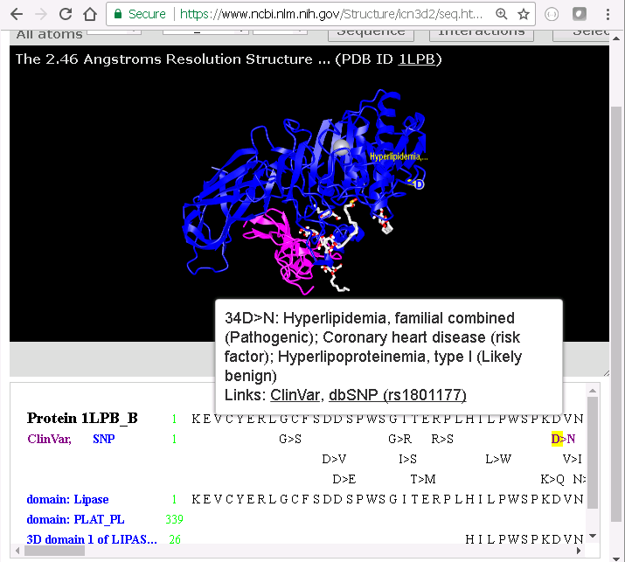
Highlight ClinVar Disease Nameon 3D Structure

Slide 3
Acknowledgment
Hackathon Team
Minghong Ward
Timothy Hefferon
Justin Foley
Takako Takeda
Jiyao Wang
Other NCBI members
Lon Phan
Peter Cooper
Tao Tao
Jonathan Kans
Peter Meric
Doug Hoffman
Hua Zhang
Ben Busby

